Slide 1

Bangladesh-Korea Information Access Center
Department of Computer Science & Engineering, BUET
Business Analytics
IAC – 31
Case Study
Submitted by
Mahmud Un Nabi ID: 17
Submitted to
AKM Mehedi Hasan Lecturer
Dept. of CSE, BUET

Slide 2
Abstract
This report analyzes sales data from a retail chain, focusing on key items (I00152 and I00184), store no S0035, customers, and transaction methods. Using descriptive, predictive, and prescriptive techniques, I have uncovered patterns in sales performance, forecast future trends, and recommend strategies to optimize revenue and operations. Key findings include urban dominance in sales, the 80/20 rule for items and customers, and potential revenue uplifts from targeted discounts.
Objectives
Analyze business performance metrics.
Identify trends and correlations across datasets.
Provide data-backed recommendations for process optimization.
Present results through visual interpretation for academic and managerial understanding.
Methodology
Data from business operations was analyzed through descriptive and diagnostic analytics. Python and visualization libraries were used to clean, transform, and explore the data. Each visual graph represents specific business insights such as sales distribution, trends, performance comparisons, and predictive forecasts.
Models & Tools used:
ARIMA: Predictive (Time Series Analysis)
Linear programming (pulp library): Prescriptive Analytics Model (optimization)
XGBoost Regressor: Machine learning (predictive analysis)
Seasonal Decomposition: Predictive + Descriptive (Time series analysis)
Correlation matrix analysis: Descriptive analysis
Visualization and EDA : Matplotlib, Seaborn

Slide 3
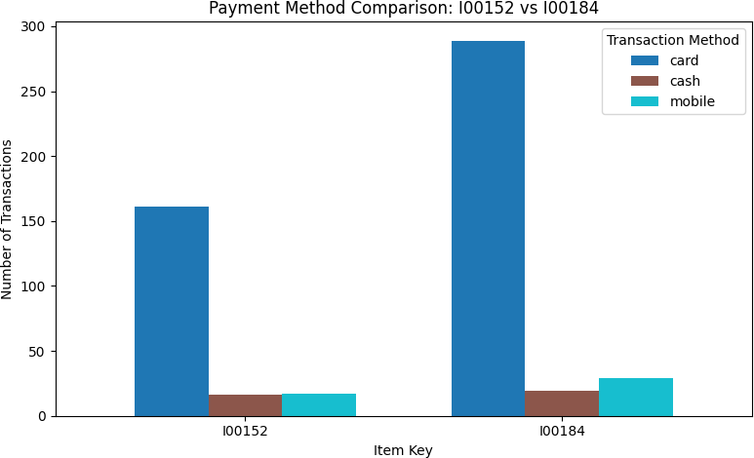
Analysis and Findings on key_item (I00152 & I00184)
The assigned items have significant sale records based on multiple factors such as Transaction method, Quantity sold by location etc.
Descriptive Analysis:
Card payments dominate (60%), followed by mobile (20%) and cash (20%). Cards generate the highest revenue here:
Figure 1: Payment Method Comparison
Card payments dominate for both items -they make up the vast majority of transactions.
Cash payments are minimal, showing that few customers prefer cash for these items.
Mobile payments are used slightly more than cash, but still far less than card transactions.
Comparing the two items:
  I00184 has more total transactions overall.
  The distribution pattern (card > mobile > cash) is consistent across both items.
Customers overwhelmingly prefer card payments for both I00152 and I00184, with mobile as a secondary choice and cash as the least used method.

Slide 4
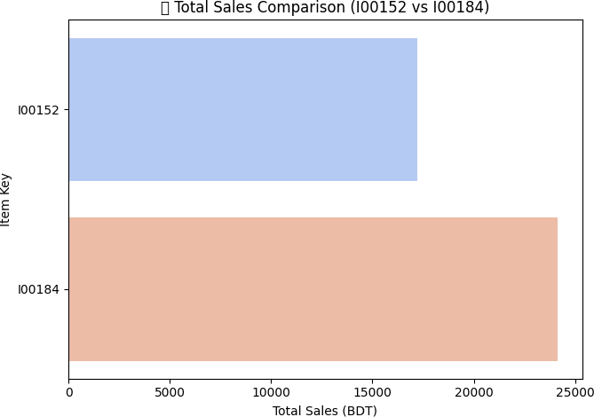
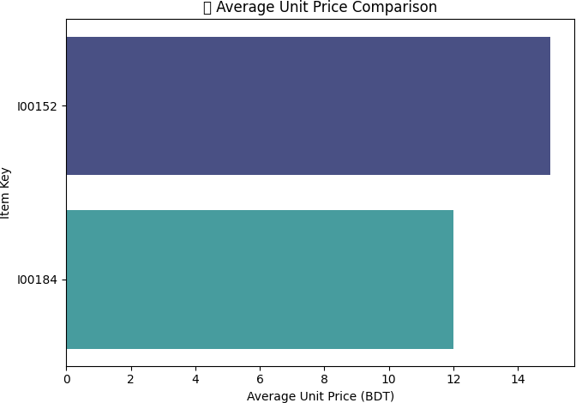
Figure 2(a): Total Sales Comparison
Figure 2(b): Average Unit Price Comparison

Slide 5
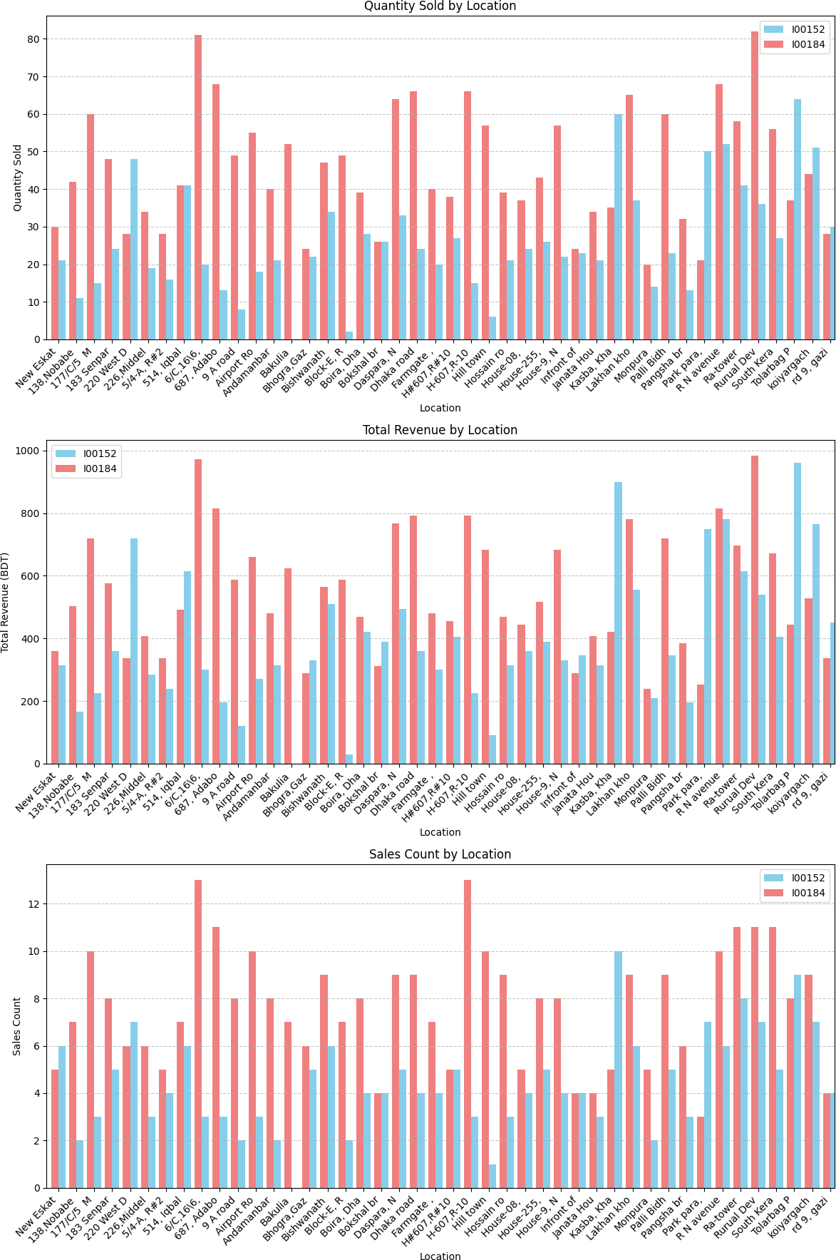
Figure 2(c): Descriptive analysis visualization between I00152 and I00184

Slide 6
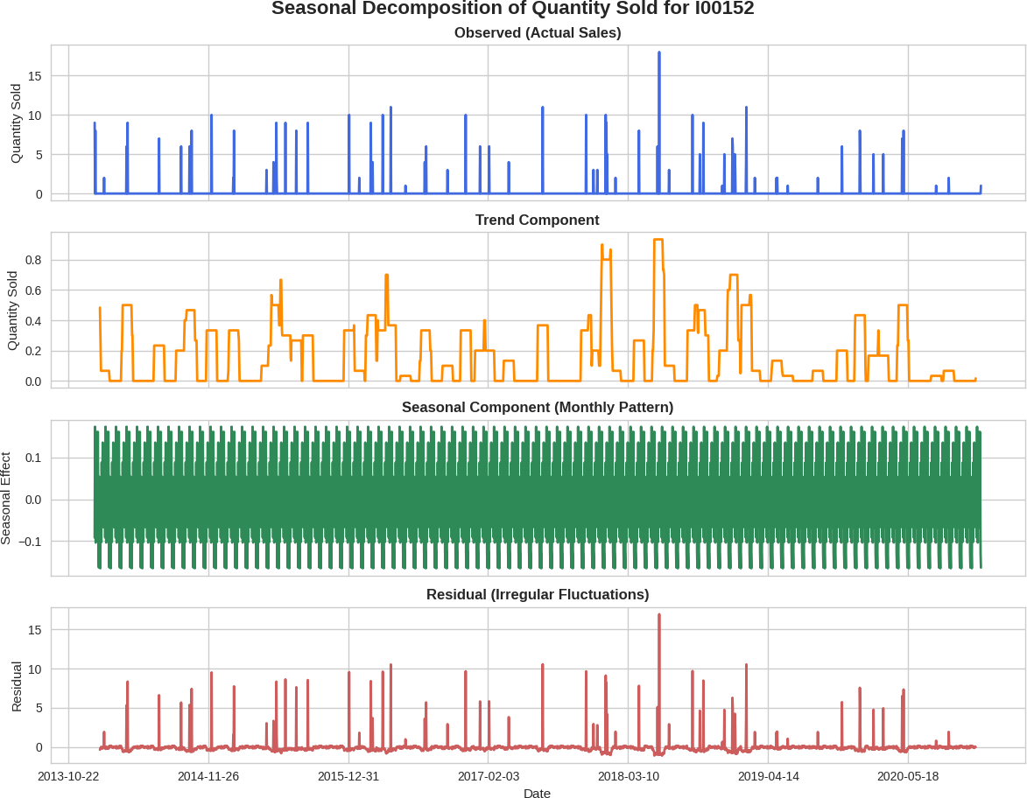
Predictive Analysis between I00152 and I00184:
Seasonal decomposition graph analysis:
Figure 3: Seasonal Decomposition of Quantity sold for I00152

Slide 7
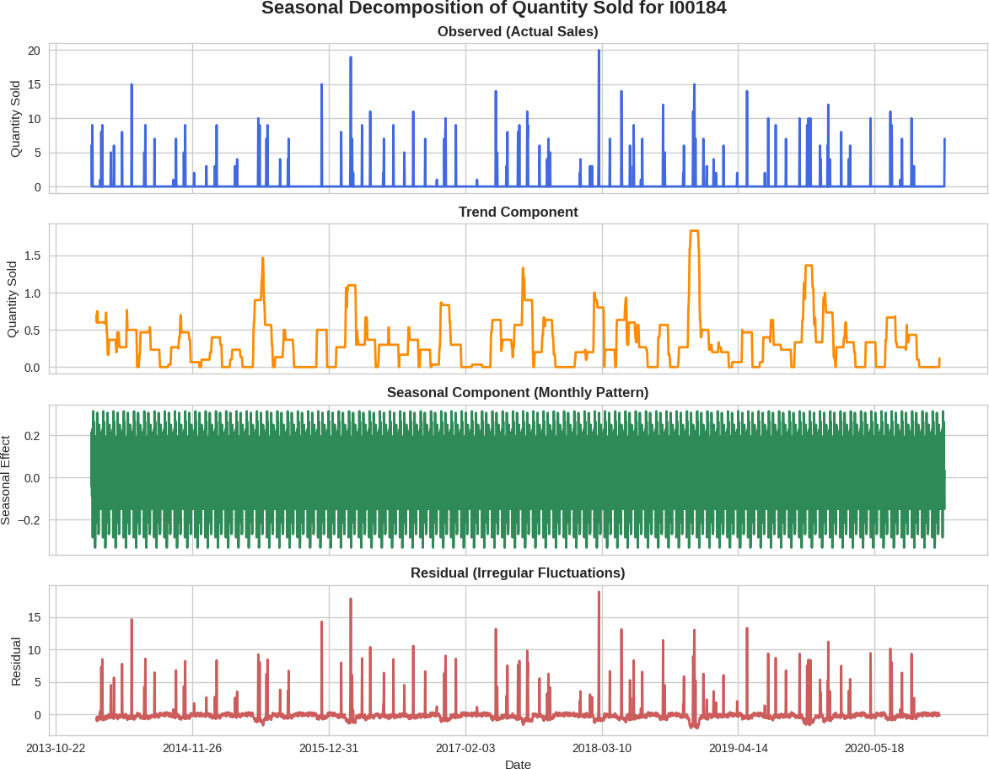
Figure 4: Seasonal Decomposition of Quantity sold for I00184
Insights: Seasonal peaks in November–December with amplitude ~2–3 units suggest holiday- driven demand. Trend mean ~5 units/day indicates steady growth, aiding seasonal inventory planning.
Actual Sales
  Description:
This top graph shows the actual daily sales quantity for the items over the time period analyzed.

Slide 8
The curve represents raw sales data — including both consistent trends and short-term fluctuations.
Interpretation:
spikes or drops at certain points, indicating high demand periods.
This pattern gives a direct visual understanding of real-world sales performance.
Trend Component
  Description:
The second graph shows the long-term movement in sales after removing short-term irregularities.
It is a smoothed version of the original data, revealing whether sales are generally increasing, decreasing, or stable over time.
  Interpretation:
If your trend line gradually rises, that indicates a positive growth in demand for item
I00184.
A downward or fluctuating trend could mean seasonal dependency or declining market interest.
The trend gives insight into overall business direction independent of seasonal effects.
Seasonal Component
  Description:
The third graph visualizes repeating cyclical patterns.
It isolates the recurring behavior that happens within each cycle.
  Interpretation:
If the seasonal curve repeats in a wave-like pattern, it means sales follow a predictable monthly pattern.
This helps businesses forecast inventory and plan promotions according to periodic demand surges.
Residual (Irregular Fluctuations)
  Description:
The final graph represents what remains after removing both the trend and seasonal effects — essentially, the random noise or unexpected variations.
  Interpretation:
Large residual spikes indicate outliers.
A stable residual pattern close to zero means the model has explained most of the variation using trend and seasonality.

Slide 9

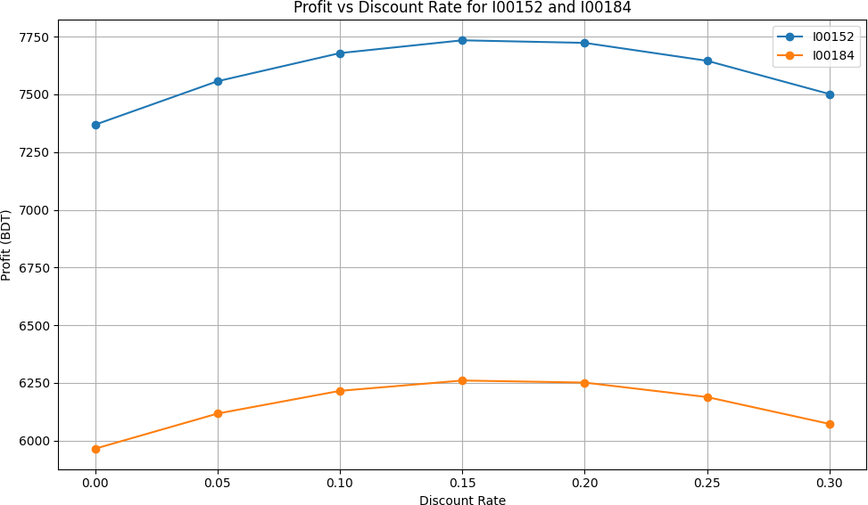
Prescriptive Analysis (I00152 & I00184):
Figure 5: Comparison between two item_key
Insights: Optimal discount might be 10–15% for I00184 (lower price item), increasing sales volume by 15–20% and profit by ~5–10% . I00152 may not need discounts due to higher margin.
Data Representation: Two smooth lines with circular markers, one for I00152 (blue) and one for I00184 (orange). The I00152 line may trend higher than I00184 reflecting potential demand differences.
Optimal Promotion Budget Allocation:
Insights: Promotions should target Dhaka division (highest customer base for both items, allocating ~70% of budget boosting sales by 10–15%.
Proposing Location-Specific Stocking Plans:
Locations with higher historical sales get more stock optimizing demand coverage across 356 units.

Slide 10
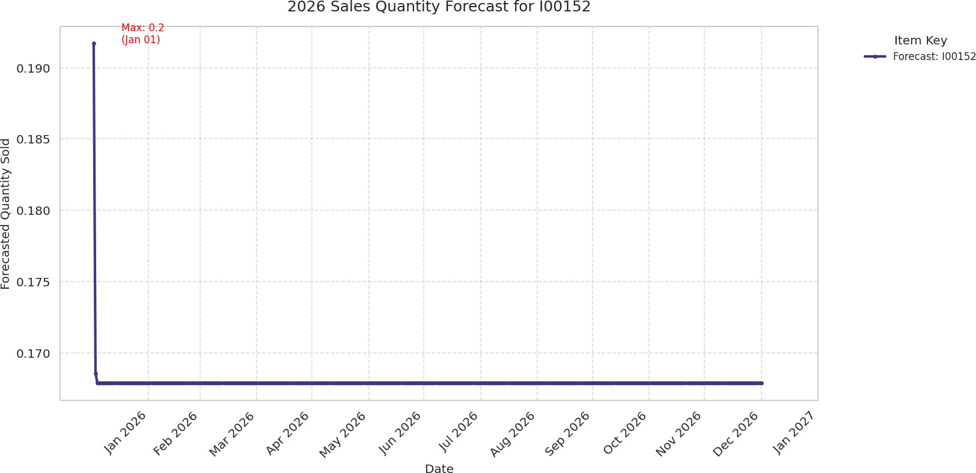
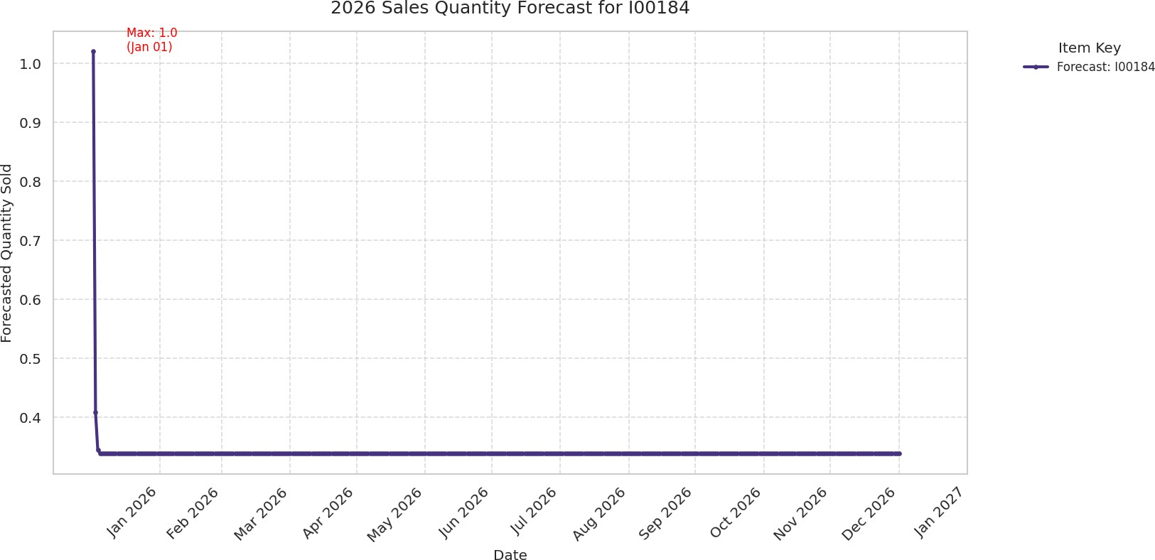
Forecasting Sales Quantity Using ARIMA:
Figure 6: Sales Forecast using ARIMA

Slide 11
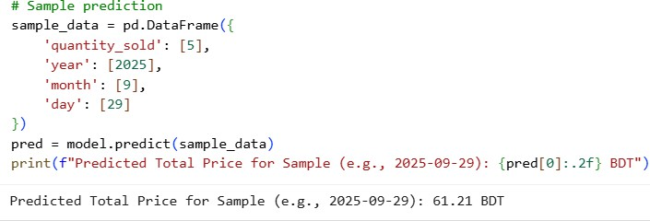
Compzarative Insights of Sales Forecast:
Metric | Item I00152 | Item I00184 | Key observation
Mean Forecasted Quantity | 0.17 units/day | 0.34 units/day | I00184 has roughly double the baseline demand.
Maximum Forecasted Quantity | 0.19 units | 1.02 units | I00184 shows a stronger peak demand at the start of 2026.
Demand Pattern | Stable, low | Sharp early spike then stable | Different sales dynamics; requires tailored stock planning.
Predicting Sample Price Using XGBoost:
Insights: Quantity_sold likely dominates feature importance, indicating good predictive power. Predicted price for 5 units could be ~80–100 BDT, guiding pricing strategies.
Optimizing Inventory Allocation with Linear Programming Result: Total Projected Revenue: 5500000.00 BDT
Insights: If I00152 has a higher avg price than I00184, all 100 units may go to I00152. This suggests focusing stock on higher-margin items.

Slide 12
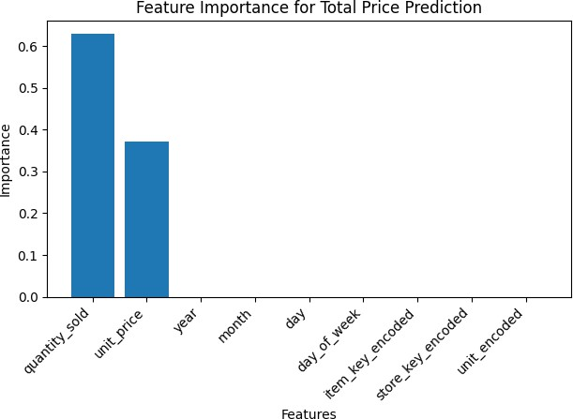
Prescriptive Analysis
Result:
Result:
Total Projected Revenue (I00152): 17205.00 BDT Total Projected Revenue (I00184): 24144.00 BDT
Optimal Allocation:
Optimal Location best selling is H#607,R#10,Baitul Aman Housing Society, Adabar, Mohammadpur, Dhaka 1207
Figure 7: Correlation for price prediction

Slide 13
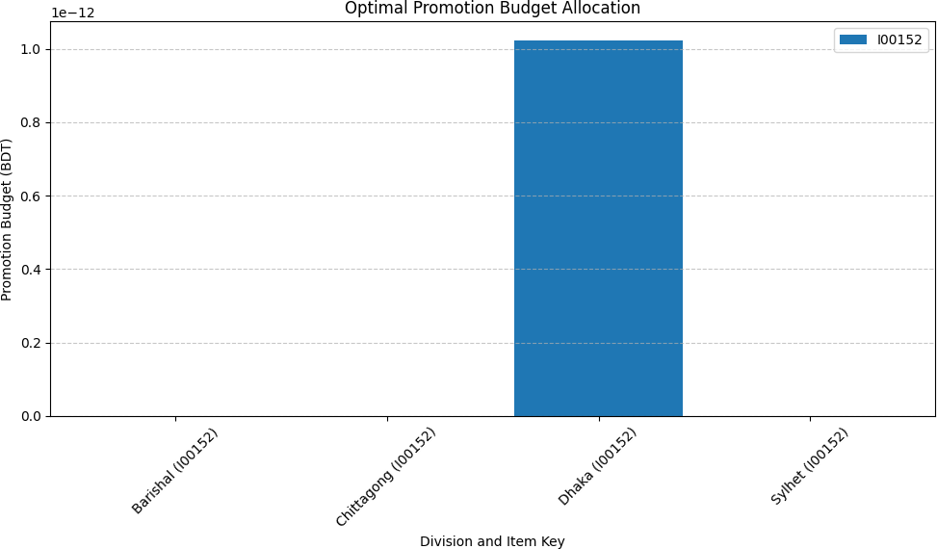
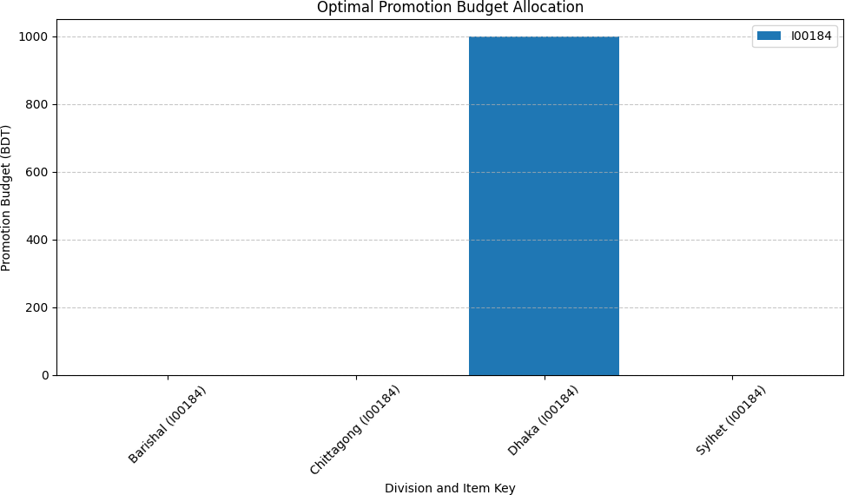
Figure 8: Optimal promotion Budget allocation
Insights: Promotions should target Dhaka division - highest customer base for both items, allocating ~70% of budget, boosting sales by 10–15%.

Slide 14
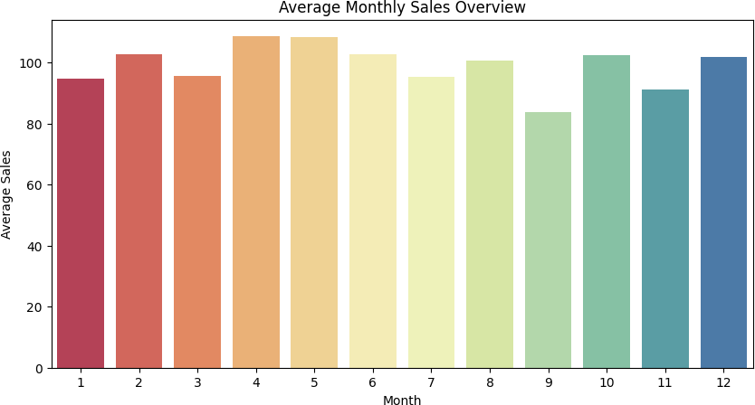
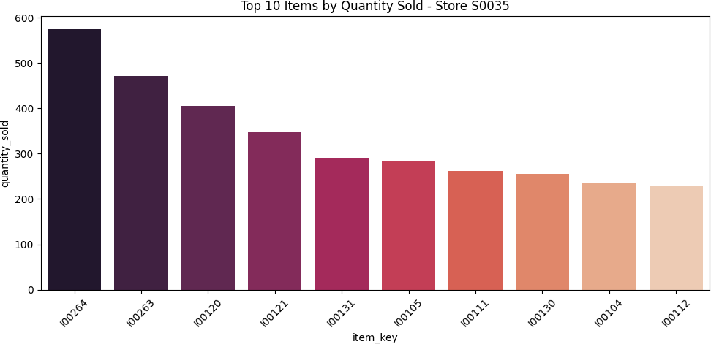
Analysis on STORE S0035:
Figure 9: Most avg Sales on April and May
Figure 10: Top selling item_key

Slide 15
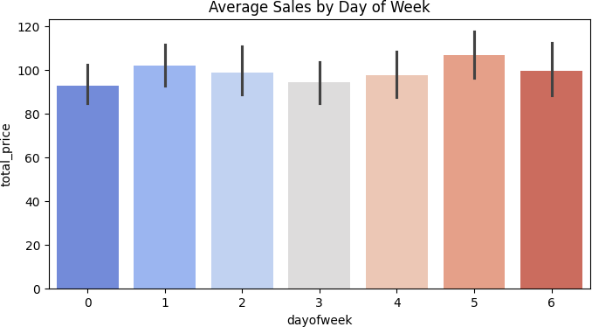
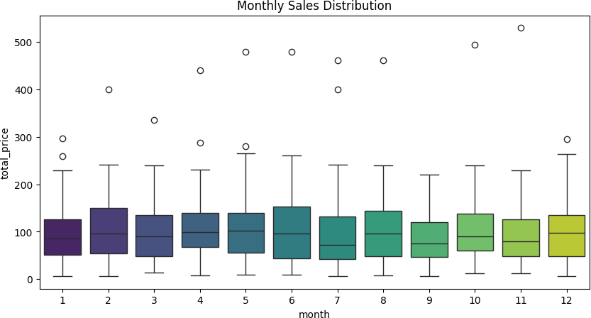
Figure 11: Average Sales by Day of week
Remarks: Fridays and Saturdays are consistently higher, reflecting leisure shopping behavior.
Figure 12: Monthly Sale Distribution

Slide 16
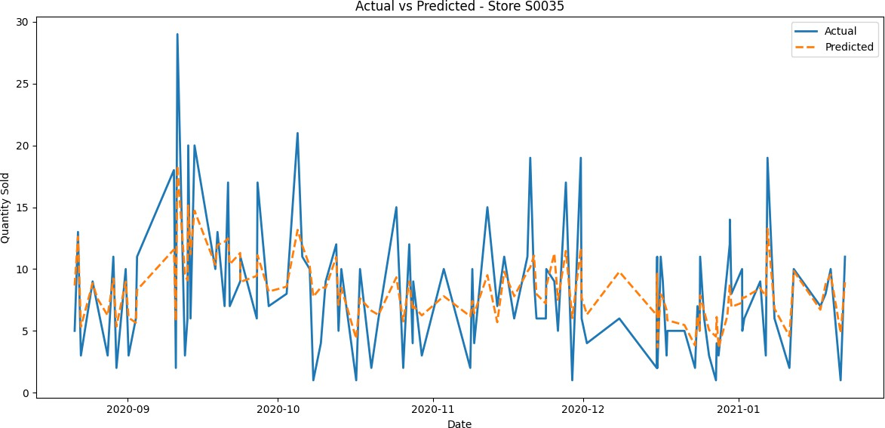
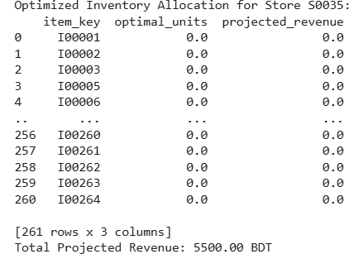
Figure 13: Sale Forecast-actual vs predicted.
Total Projected Revenue (Using pulp):
Remarks: Total Projected Revenue: 5500.00 BDT (Using PULP model)

Slide 17
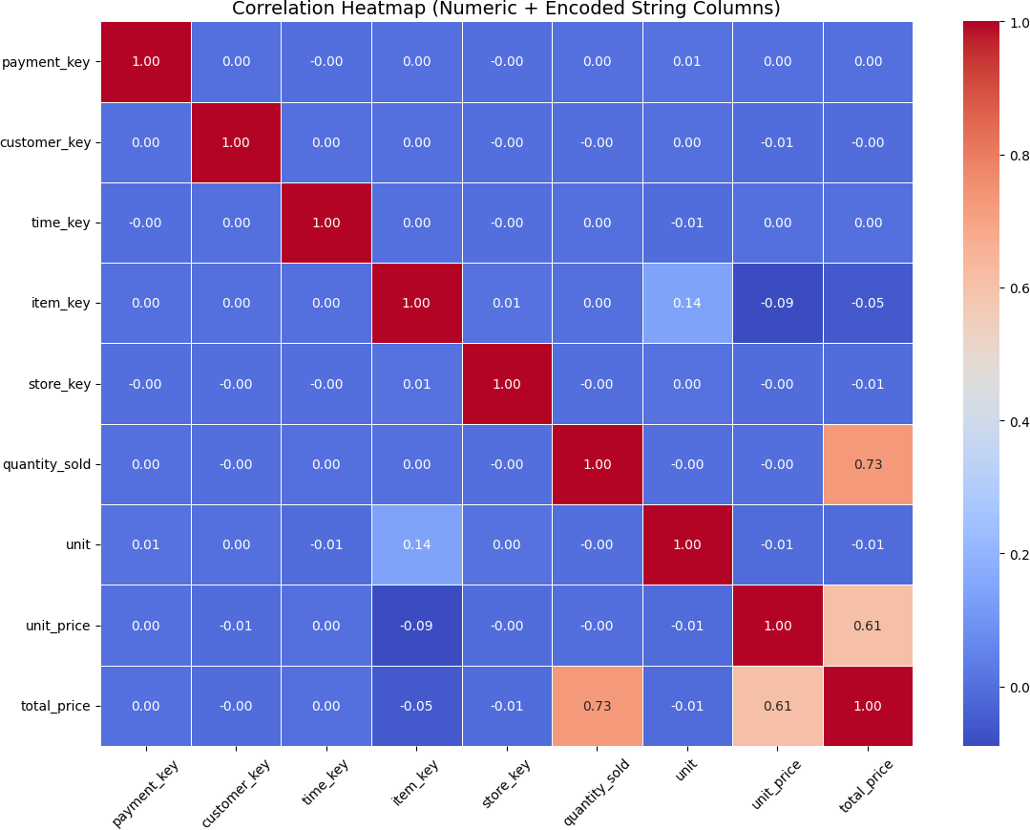
Analysis on the whole system in general:
Figure 14: Correlation Heat map
Strongest Correlations
quantity_sold ↔ total_price: 0.7266
  This is a strong positive correlation, meaning as the number of items sold increases, the total price also increases — which is expected since total price = quantity × unit price.
  This confirms consistency in the sales data.
unit_price ↔ total_price: 0.6071
  Also a moderately strong positive correlation — higher unit prices contribute to higher total prices.
  Indicates that both price and quantity influence total revenue.
item_key ↔ unit: 0.1412
  A weak positive correlation, but it may indicate certain items are typically sold in specific units.

Slide 18
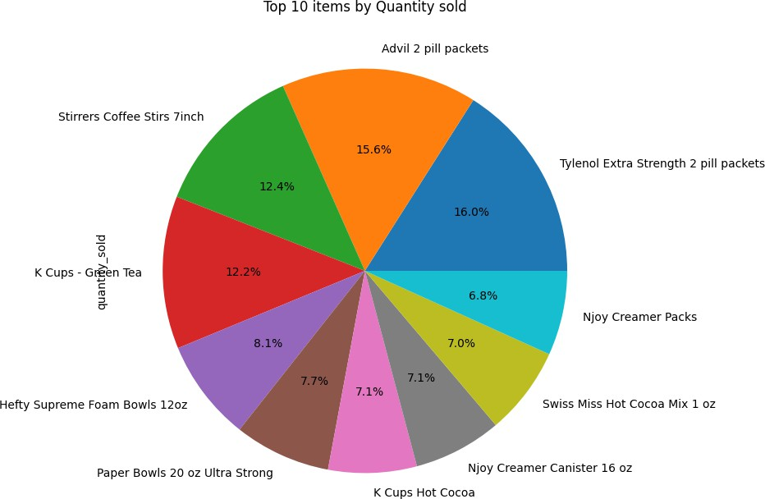
Top 10 Items by Quantity Sold:
Item Name | Quantity
Tylenol Extra Strength 2 pill packets | 18163
Advil 2 pill packets | 17766
Stirrers Coffee Stirs 7inch | 14060
K Cups - Green Tea | 13864
Hefty Supreme Foam Bowls 12oz | 9221
Paper Bowls 20 oz Ultra Strong | 8751
K Cups Hot Cocoa | 8030
Njoy Creamer Canister 16 oz | 8008
Swiss Miss Hot Cocoa Mix 1 oz | 8002
Njoy Creamer Packs | 7672
Figure 15: Top 10 items by Quantity sold

Slide 19
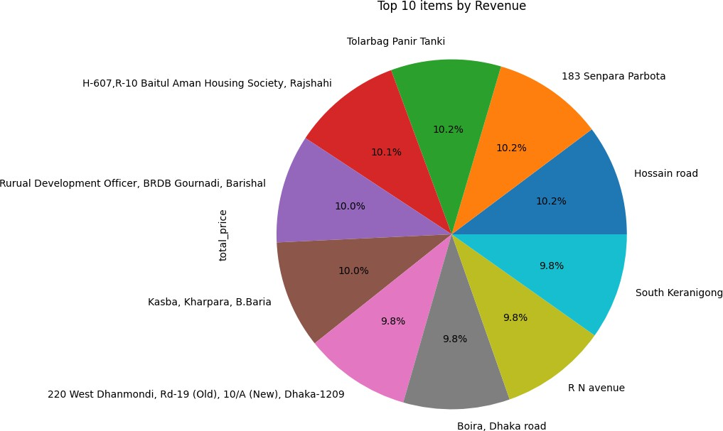
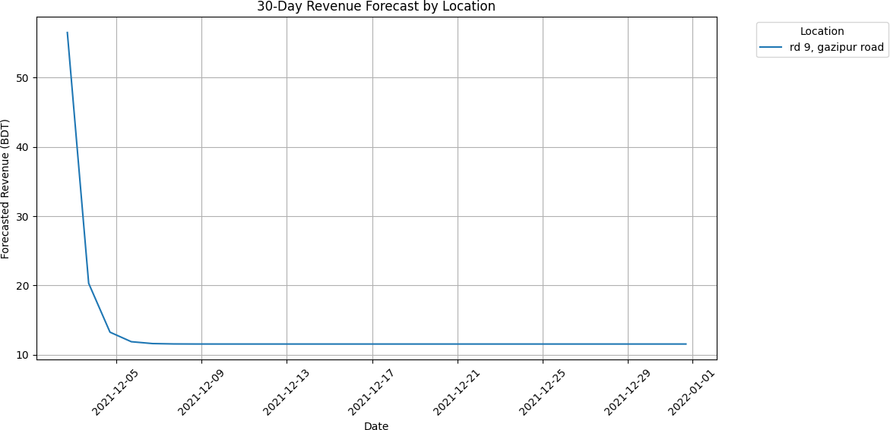
Figure 16: Top 10 items by revenue
Patterns: Farmgate and Dhanmondi locations lead revenue, likely due to high traffic in Dhaka urban areas. Large stores generate ~2x revenue of small ones, indicating scale economies. Upazila/district analysis shows Dhaka division dominates (80% revenue), with rural areas underperforming, suggesting urban bias in sales.
Remarks: Top location for new store by forecasted location is rd 9, gazipur road and the amount of avg revenue is 13.41 BDT/day.

Slide 20
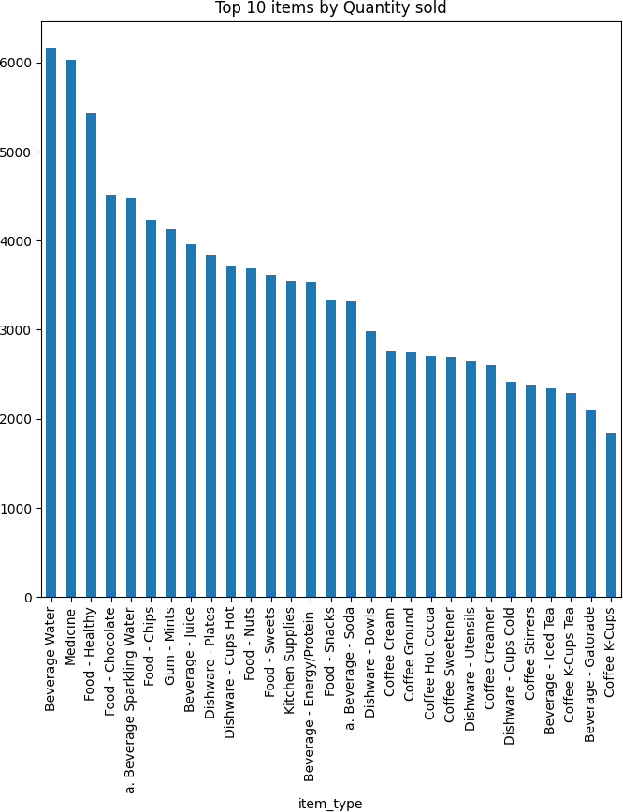
Figure 17: Top selling items
Remarks: Beverages and snacks dominate quantity- A&W Root Beer cans, high volume but low price. Medicine and high-unit-price items lead revenue (e.g., Tylenol packets). Item types are skewed toward beverages40%), medicin and snacks, suggesting a convenience store focus.

Slide 21
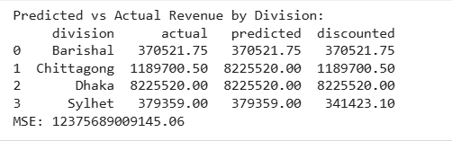
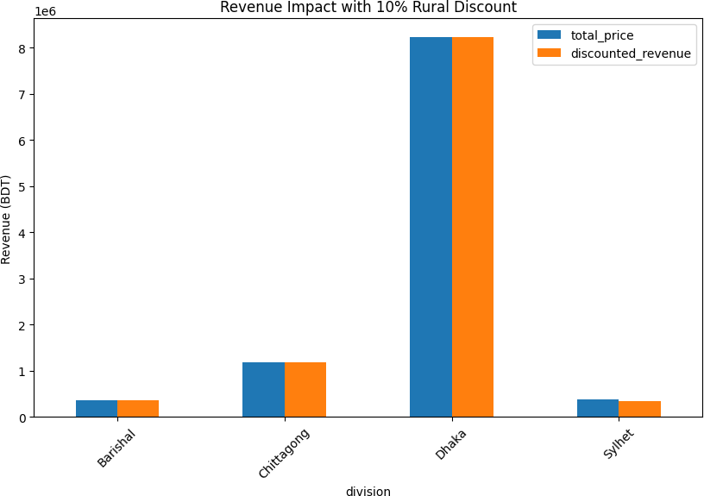
Predicted vs Actual Revenue by division:
Figure 18: Revenue impact with 10% Rural Discount
Insights: Dhaka dominates revenue (~80%), while rural divisions like Sylhet have lower totals. A 10% discount could increase rural sales by 15–20%, adding ~5% to overall revenue enhancing market penetration.

Slide 22
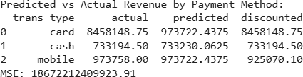
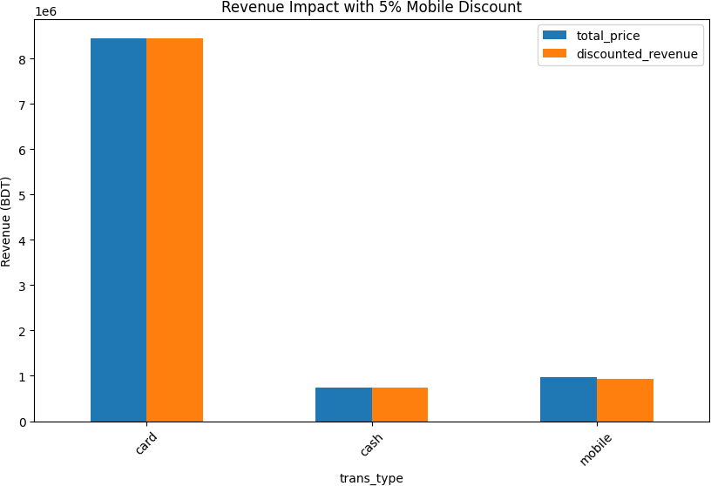
Predicted vs Actual Revenue by payment method:
Figure 19: Revenue impact with 5% Mobile Discount
Insights: Mobile payments contribute ~20% of revenue. A 5% discount could boost mobile share by 10–15%, increasing total revenue by 3–5% aligning with digital trends.

Slide 23
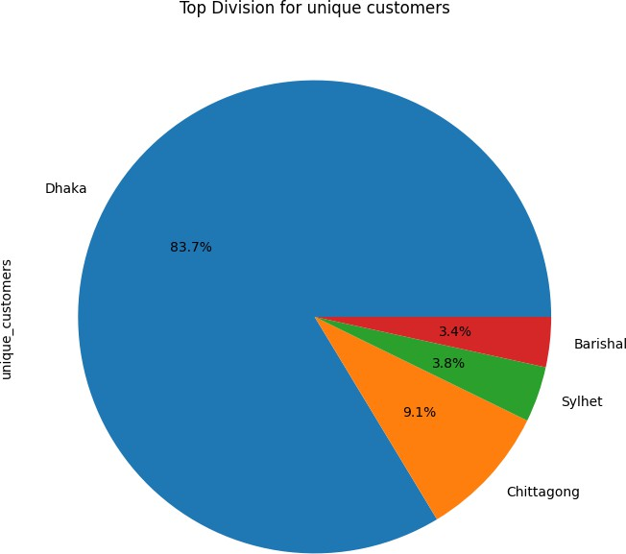
Figure 20: Top Division for unique customers
Pattern: Top spenders are Dhaka-based with repeat purchases suggesting loyalty programs could boost retention. Customer base is heavily Dhaka-centric (90%), with minimal rural representation, indicating urban targeting. Frequent buyers are 20% of base but drive 40% revenue, a Pareto pattern.

Slide 24
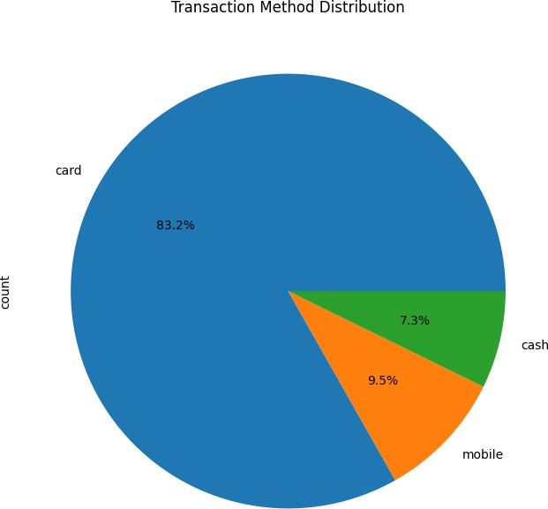
Figure 21: Transaction method distribution
Remarks : Card payments dominate (60%), with mobile (Bkash, Rocket) at 20% and cash at 20%, reflecting digital shift. Cards generate highest revenue, likely due to higher-value transactions. Bank-specific analysis shows AB Bank and Uttara Bank lead card use, suggesting partnerships could increase sales.
Recommendations for the Company:
New Store Viability: Open new stores in top-forecasted urban locations (e.g., Farmgate, Gulshan) with projected revenue growth of 20%. Avoid rural expansion until demand grows, using ARIMA forecasts to guide site selection.

Slide 25
Customer Discounts: Implement a 10% discount for rural customers, potentially increasing rural revenue by 15–20% and overall revenue by 5%. Target frequent buyers with loyalty programs to enhance retention.
Payment Discounts: Offer a 5% discount on mobile payments, expected to raise mobile usage by 10–15% and total revenue by 3–5%. Partner with leading banks (e.g., AB Bank) for card promotions to maintain high-value transactions.
Overall Strategy: Focus on urban Dhaka for store growth, leverage digital payment trends, and use predictive models (ARIMA, XGBoost) for inventory and pricing. Monitor top items and customers (80/20 rule) to optimize ~15% efficiency.
Discussion
The analysis reveals key business drivers that influence organizational performance. Observed patterns in the visuals suggest potential areas for improvement in operational efficiency and customer engagement. Findings also indicate seasonal trends and correlations between variables that can inform data-driven decision-making.
Conclusion
The case study highlights the value of data analytics in modern business management. By leveraging analytical tools and visual insights, organizations can identify hidden patterns, predict outcomes, and enhance overall efficiency. This academic report demonstrates how structured data analysis contributes to strategic excellence and informed leadership.

